Slide 1
Lab 4
2015 OOP
Instructor: 黃柏翰

Slide 2
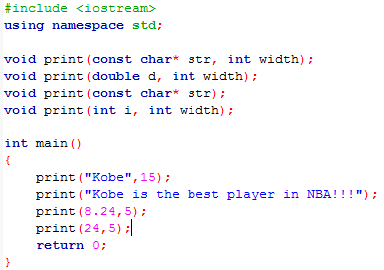
Overloading
Function Overloading
Use the number and the type of the parameters to call the correct function whose name is same as others.

Slide 3
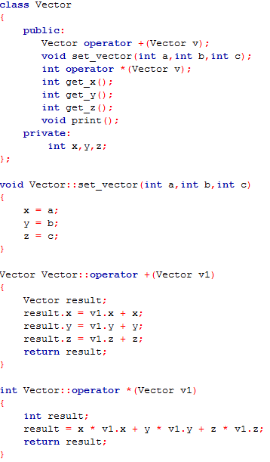
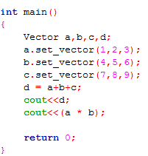

Overloading
Operator Overloading
Let the operator exist another
meaning, such as “+” and “*”
both exist default meaning but
you want to change it.

Slide 4

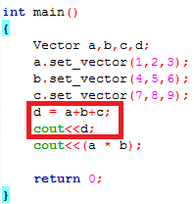

Overloading
Operator Overloading(mainly for “<<”)
When you want to print out the content which is defined by yourself like the example code Vector, you have to implement the “<<” operator overloading.

Slide 5
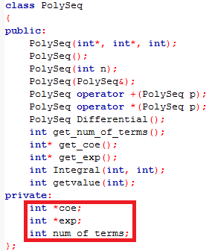
Today Practice
Introduction
Implement the Addition, Multiplication, Differential, and calculate the value of the polynomial sequence.
Requirement
1. Must use the constructor to create
a new polynomial sequence.
2. All of the variables in the class
must be put into the private area.
(just like the figure as follow, but
there’s no need for the same as mine.)
(Hint: If you declare the fixed array
instead of the pointer, it’s much easier
to implement this lab.)

Slide 6
Today Practice
Requirement
3. It’s essential to use the operator overloading - to implement the Subtraction of the polynomial sequence.
4. It’ essential to use the operator overloading * to implement the Multiplication of the polynomial sequence.
5. It’s essential to use the operator overloading << to print out the polynomial sequence.

Slide 7
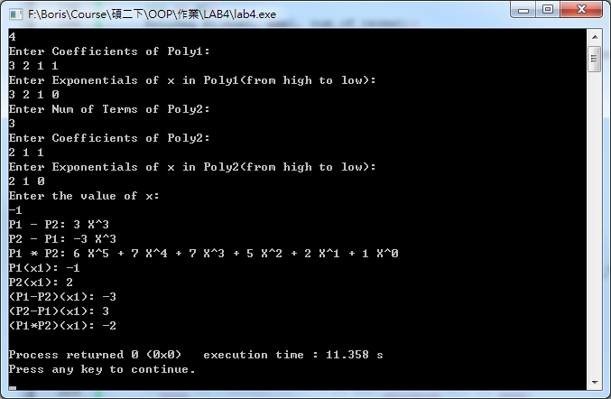
Today practice
Sample I/O (Notice: The num of terms of Poly1 is either bigger or smaller than the num of terms of Poly2.)

